Slide 1
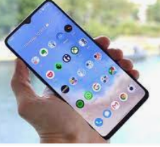
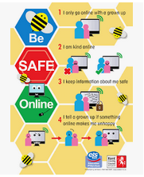
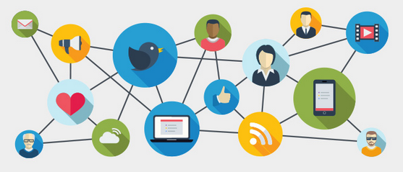
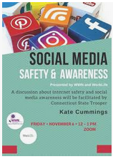
The Internet & Social Networks
Http:
Index.htm Splash Page
Packets
Domain
URL
WWW
How to use the internet
and how to behave on social networks
Browser
At the end of this presentation is a brief history of how the Internet started
Peter J Faulks
Peter J Faulks The Internet & Social Networks Slide 1

Slide 2
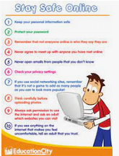
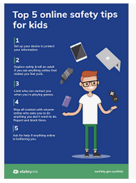
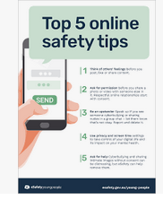
The Internet and Social web sites
Task 4
Students will create an A4 poster on
1. Appropriate use of the internet
or
2. How to behave on Social Networks
A4 poster page or image should include text and pictures be sent to the teacher by
next week.
Peter J Faulks The Internet & Social Networks Slide 2

Slide 3
Searching for something on the Internet Open a browser window and type what you are searching for – Which browser, any will do?
Internet Explorer was one of the first browsers
Netscape was one of the first browsers where you could create sites
Peter J Faulks The Internet & Social Networks Slide 3

Slide 4
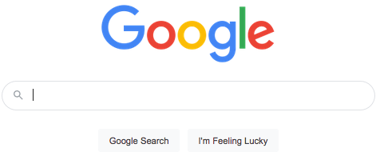
Searching for something on the Internet Open a browser window and type what you are searching for – Which browser, any will do?
Just type in here
A search will bring up search options
All images News Videos or Shopping and more
Peter J Faulks The Internet & Social Networks Slide 4

Slide 5
Searching for something on the Internet Open a browser window and type what you are searching for in the search box.
You have a toolbox and a toolbar for your favourite sites, and a browser box you can also just type into
Back Forward Reload Home Tabs of previous searches Favorites saved bookmarks Sidebar Account Downloads
https = a secure site://www(search world wide web), google (company), .com (domain type)
type of company and next would be country like .au (Australia) but if no country is shown
it is an American site
A more secure browser
Why Google well …. A googol is 10 to the 100th power (which is 1 followed by 100 zeros). A googol is larger than the number of elementary particles in the universe, so they chose the name Google an appropriate name for searching over 3 Billion sites!
Peter J Faulks The Internet & Social Networks Slide 5

Slide 6
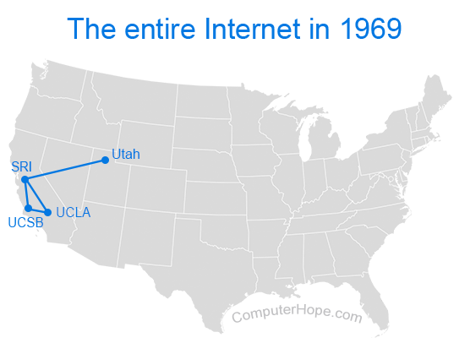
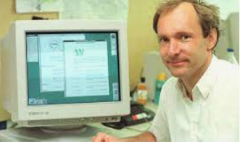
The language of the Internet
Initially not many people used the internet but when personal computers came out late 1970’s and early 1980’s a demand to share information was needed.
So when a language for working the internet (HTTP HyperText Transfer Protocol) was created everything changed rapidly.
Tim Berners-Lee
Development of HTTP was initiated by Tim Berners-Lee at CERN
in 1989 and summarized in a simple document describing the
behaviour of a client and a server using the first HTTP protocol
version that was named 0.9.
Peter J Faulks The Internet & Social Networks Slide 6

Slide 7
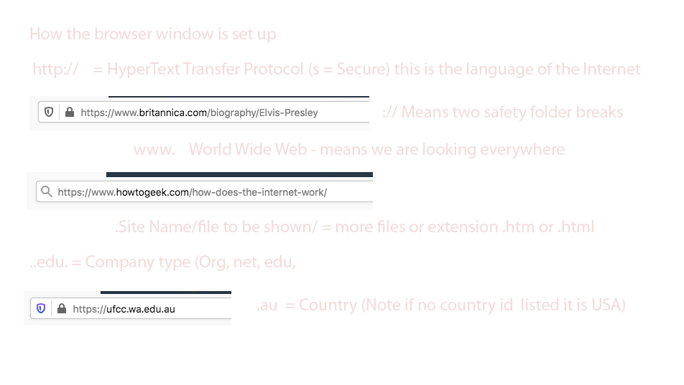
Searching for something on the Internet Open a browser window and type what you are searching for in the search box.
Peter J Faulks The Internet & Social Networks Slide 7

Slide 8
Then the world wide web goes searching at 164,000 mbs per second
Search engines work by crawling hundreds of billions of pages using their own web crawlers. These web crawlers are commonly referred to as search engine bots or spiders. A search engine navigates the web by downloading web pages and following links on these pages to discover new pages that have been made available.
Average search is fast, returning approx 3.44 million results in 0.28 seconds. – Impressive hey!
https://www.deepcrawl.com/knowledge/technical-seo-library/how-do-search-engines-work/
Peter J Faulks The Internet & Social Networks Slide 8

Slide 9
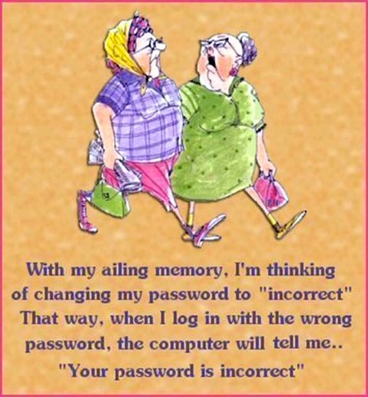
So how do we get a site put up on the internet?
We need to purchase a domain name
We need to find an Internet Service Provider (ISP)
We use an authoring application like (Dreamweaver) to create our page, this app comes with code, code and design and just design so you can see your page when the code is being written.
Then we need a Transfer Protocol Application (FTP) to send or files to a folder where our site lives.
We then upload our site to the internet browsers.
Your site will have a unique i.p. (Internet Protocol), which is the set of rules governing the format of data sent via the internet or local network address like 208.67.222.222 and a password just for you to upload to your site.
Peter J Faulks The Internet & Social Networks Slide 9

Slide 10
So how do we get a site put up on the internet?
We need to purchase a domain name so lets say we want to sell candy via the internet and we have a name
We are offered various options and a price for the domain name (usually 2 year licence).
.com = company
.net=network
.org=organisation
.co=corporation
Alternative name
.info=information
Peter J Faulks The Internet & Social Networks Slide 10

Slide 11
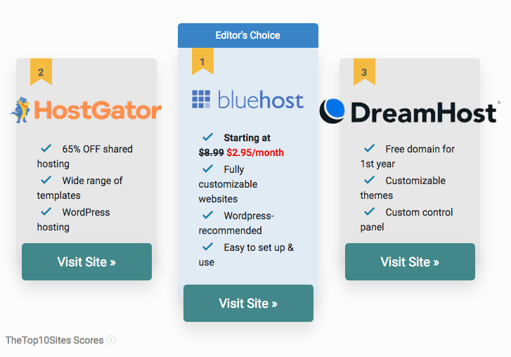
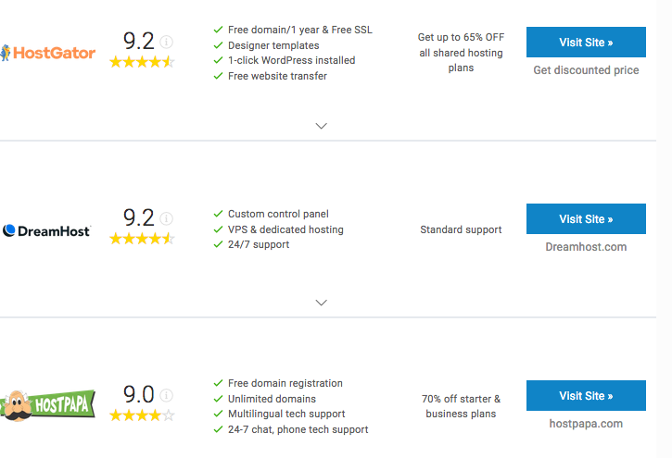
So how do we get a site put up on the internet?
We need to purchase a domain name
We need to find an Internet Service Provider (ISP)
These will offer to HOST your site for a fee and some also get the domin name for you.
Usually the people providing your internet will also be able to offer hosting,
You pay the fee and they send you your ip address for the File Transfer Program (FTP that you will use)
Peter J Faulks The Internet & Social Networks Slide 11

Slide 12
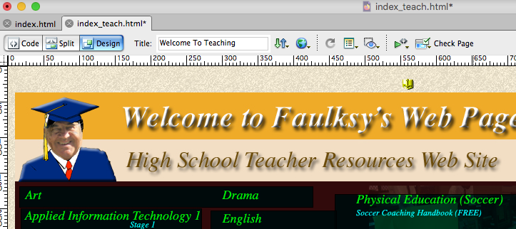
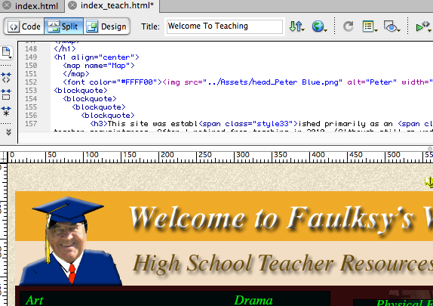
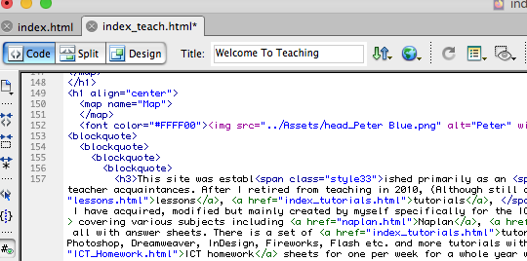
So how do we get a site put up on the internet?
We need to purchase a domain name
We need to find an Internet Service Provider (ISP)
We use an authoring application like (Dreamweaver) to create our page, this app comes with code, code and design and just design so you can see your page when the code is being written.
Design View
Split code & Design View
Code View (http language)
Peter J Faulks The Internet & Social Networks Slide 12

Slide 13
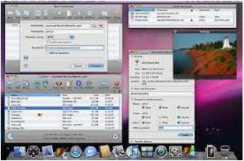
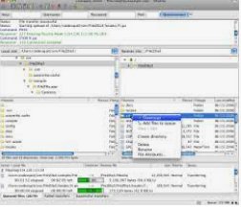
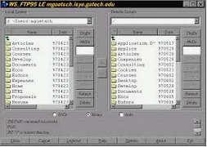
So how do we get a site put up on the internet?
We need to purchase a domain name
We need to find an Internet Service Provider (ISP)
We use an authoring application like (Dreamweaver) to create our page, this app comes with code, code and design and just design so you can see your page when the code is being written.
Then we need a Transfer Protocol Application (FTP) to send or files to a folder where our site lives.
FTP programs
or applications
Fetch FTP program (Mac)
Filezilla FTP program (Mac)
WS_FTP95: a FTP Client (Windows)
Peter J Faulks The Internet & Social Networks Slide 13

Slide 14
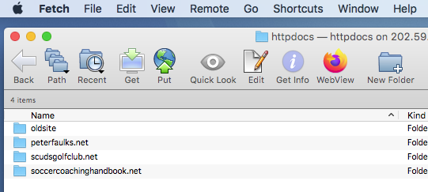
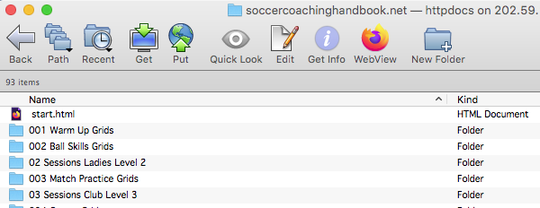
So how do we get a site put up on the internet?
We need to purchase a domain name
We need to find an Internet Service Provider (ISP)
We use an authoring application like (Dreamweaver) to create our page, this app comes with code, code and design and just design so you can see your page when the code is being written.
Then we need a Transfer Protocol Application (FTP) to send or files to a folder where our site lives.
Folders (Sites) Open a folder
and click on Put
then find the site on your computer
Then we advertise our web page using
Peter J Faulks The Internet & Social Networks Slide 14

Slide 15
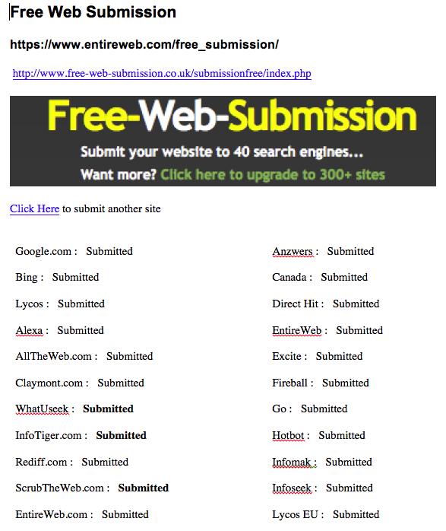
So how do we get a site put up on the internet?
We need to purchase a domain name
We need to find an Internet Service Provider (ISP)
We use an authoring application like (Dreamweaver) to create our page, this app comes with code, code and design and just design so you can see your page when the code is being written.
Then we need a Transfer Protocol Application (FTP) to send or files to a folder where our site lives.
5. We then upload our site to the
internet browsers. using URL’s
Next we need to upload our Universal
Resource Locator (URL) to various sites
The free ones might will hit you with spam
But you can upload to Google if they
Accept your site
Each site page (htm or html) will need
To be uploaded with a description
using meta tags (words that relate to
your site) like
Candy, Sweets, lollies etc..
Peter J Faulks The Internet & Social Networks Slide 15

Slide 16
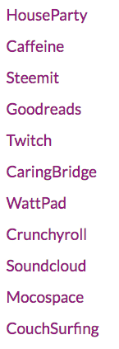
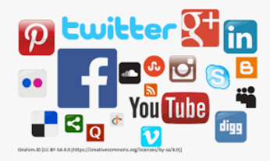
Social Networks
A social network is a website that allows people with similar interests to come together and share information, photos and videos. People engaged in social networking may be doing so as a personal or a business endeavor.
Social media sites have also grown in numbers by leaps and bounds. As per the statistics revealed on Statista, approximately 2 billion users used social networking sites and apps in 2015. And, with the increased use of mobile devices, this number is likely to cross the 2.6 billion mark by 2018. Now it is over 3 billion.
Peter J Faulks The Internet & Social Networks Slide 16

Slide 17
Social Networks
What Is Social Networking?
The term social networking refers to the use of internet-based social media
sites to stay connected with friends, family, colleagues, customers, or clients.
Social networking can have a social purpose, a business purpose, or both, through sites like Facebook, Twitter, LinkedIn, and Instagram. Social networking is also a significant base for marketers seeking to engage customers. Facebook remains the largest and most popular social network, with 2.91 billion people using the platform on a monthly basis, as of Dec. 31, 2021.
Instagram, Facebook Messenger, Twitter, and Pinterest are the next most popular, according to Statista.
What you post stays on the internet forever so be careful what you post there are 3 billion people that can see and copy your content, Remember a friend today may not be friendly tomorrow…
https://www.shortstack.com/blog/best-social-networks-to-reach-specific-demographics/https://www.investopedia.com/terms/s/social-networking.asp
Peter J Faulks The Internet & Social Networks Slide 17

Slide 18
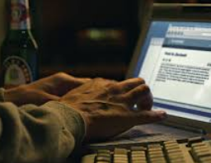
Advantages of Social Networks
The Ability to Connect to Others
Instant, Easy Communication
Real-Time News and Access to Information
Opportunities for Business Owners
Enjoyment and Relaxation
Self Promotion (Selfies at restaurants etc.)
Disadvantages of Social Networks
Privacy Issues
Too Much Information
Cyber-Bulling and Peer Pressure
Self-Isolation
Procrastination and Distraction
Disruption of Sleep and Sedentary Lifestyle Habits
Not everything is true you can find all sorts of information some of it will be untrue or false!
https://whatt.org/pros-and-cons/social-networking/
Peter J Faulks The Internet & Social Networks Slide 18

Slide 19
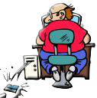
Social Networks 2007 on
Childhood was more or less unchanged for several millennia, but since
the birth of social media in 2007 the world for grown-ups has
completely changed.
Twenty years ago, our parents worried about stranger danger and whether or not we were home by the time the streetlights came on.
But for parents raising the first generation of kids with smartphones, everything is different. Digital Danger lurks on every network!
Sometimes a good idea can turn into something very bad. Social networking is a good example of this. It was created so that people could share thoughts and ideas with like-minded people and keep in touch with distant family. Then it evolved into the monster it is today. It is heavily involved in every aspect of your life now, even if you choose not to use it.
How many times do potential employers base their hiring decisions on what they see on social media rather than on the resume?
Be careful what you communicate on line.
Peter J Faulks The Internet & Social Networks Slide 19

Slide 20
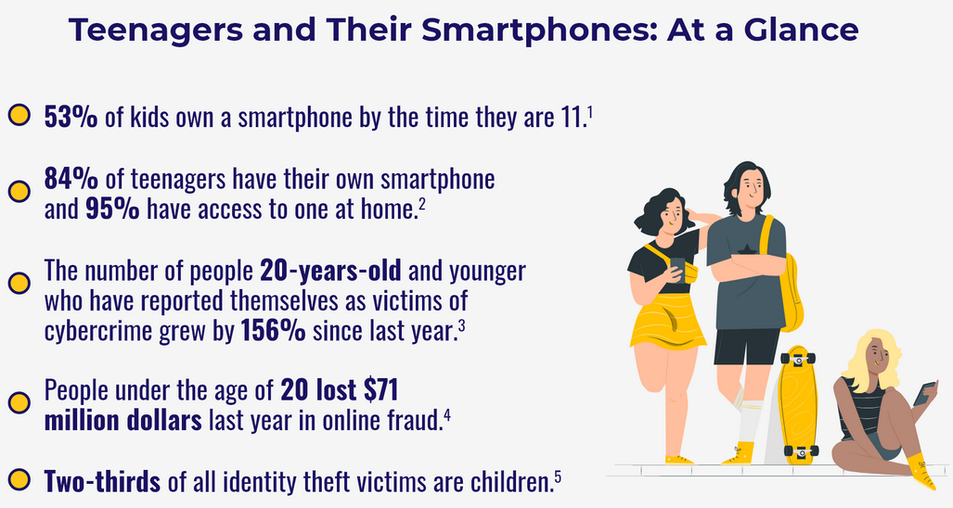
Social Networks Smartphones
in Western Australia the optical or audio recording of a private activity or conversation is prohibited under ss 5(1) and 6(1) of the Surveillance Devices Act 1998 (WA). The definitions of ‘private activity’ and ‘private conversation’ found in s 3 of the Act are broad, encompassing any activity or conversation occurring in circumstances that indicate any of the parties to the activity or conversation desires it to be seen or heard only by themselves.
Peter J Faulks The Internet & Social Networks Slide 20

Slide 21
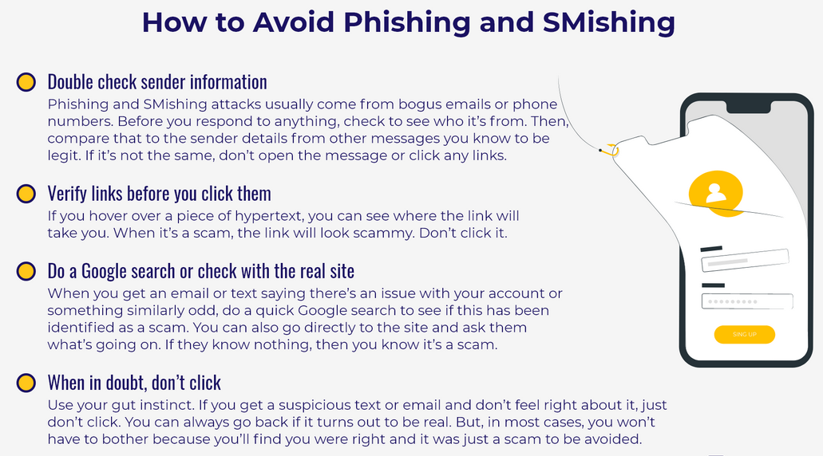
Social Network Dangers
Peter J Faulks The Internet & Social Networks Slide 21

Slide 22
Social Networks
Peter J Faulks The Internet & Social Networks Slide 22

Slide 23
Social Networks
Peter J Faulks The Internet & Social Networks Slide 23

Slide 24
Social Network Dangers
Peter J Faulks The Internet & Social Networks Slide 24

Slide 25
Social Networks
What you post stays on the internet forever so be careful what you post there are 3 billion people that can see and copy your content, Remember a friend today may not be friendly tomorrow…
Do not post to anyone you do not know, there are people just
Waiting to take your money decieve you into
meeting them, or just want your information
to possibly bully or threaten you!
Peter J Faulks The Internet & Social Networks Slide 25

Slide 26
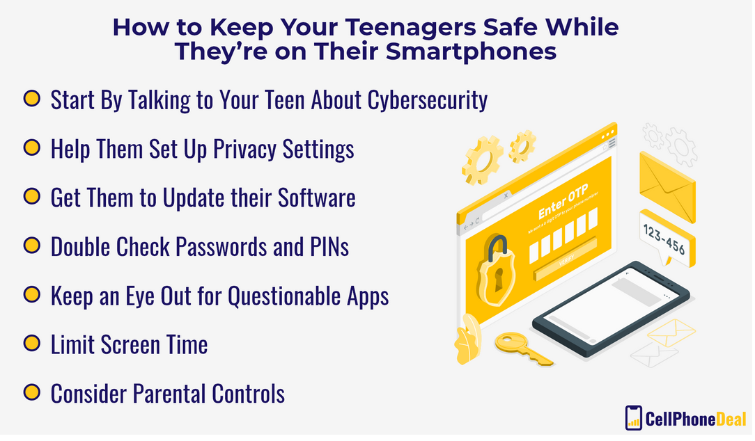
Social Network Dangers
Peter J Faulks The Internet & Social Networks Slide 26

Slide 27
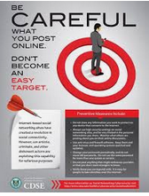
Create an A4 Poster
Create a poster
Either
Appropriate use of the Internet
Or
How to behave on social networks
Peter J Faulks The Internet & Social Networks Slide 27

Slide 28
The End

